Slide 1
Overview On Data Deduplication
Presented By: Mihir Kumar

Slide 2
An Introduction to Data Deduplication
Data Deduplication is a specialized technique for eliminating duplicate copies in large scale storage.
This technique is used to improve storage utilization and can also be applied to network data transfers to reduce the number of bytes that must be sent.
The intent of storage-based data deduplication is to inspect large volumes of data and identify large sections – such as entire files or large sections of files – that are identical, in order to store only one copy of it.

Slide 3
Brief Algorithm Of Data Deduplication
In the deduplication process, unique chunks of data, or byte patterns, are identified and stored during a process of analysis.
As the analysis continues, other chunks are compared to the stored copy and whenever a match occurs, the redundant chunk is replaced with a small reference that points to the stored chunk.
Given that the same byte pattern may occur dozens, hundreds, or even thousands of times , the amount of data that must be stored or transferred can be greatly reduced.

Slide 4
Benefits Of Data Deduplication
Storage-based data deduplication reduces the amount of storage needed for a given set of files.
It is most effective in applications where many copies of very similar or even identical data are stored on a single disk.
Virtual servers and virtual desktops benefit from deduplication because it allows nominally separate system files for each virtual machine to be coalesced into a single storage space.
If a given virtual machine customizes a file, deduplication will not change the files on the other virtual machines.

Slide 5
Parts of Deduplication Technique
Data Deduplication usually takes place in following sequence:
Files are broken down into chunks. Each of these chunks are provided with fingerprints. This process is also known as chunking.
These Unique fingerprints are used to make meta data which is used to retrieve data later on.
Different methods are used to store these chunks such that redundant chunks are not stored again.

Slide 6
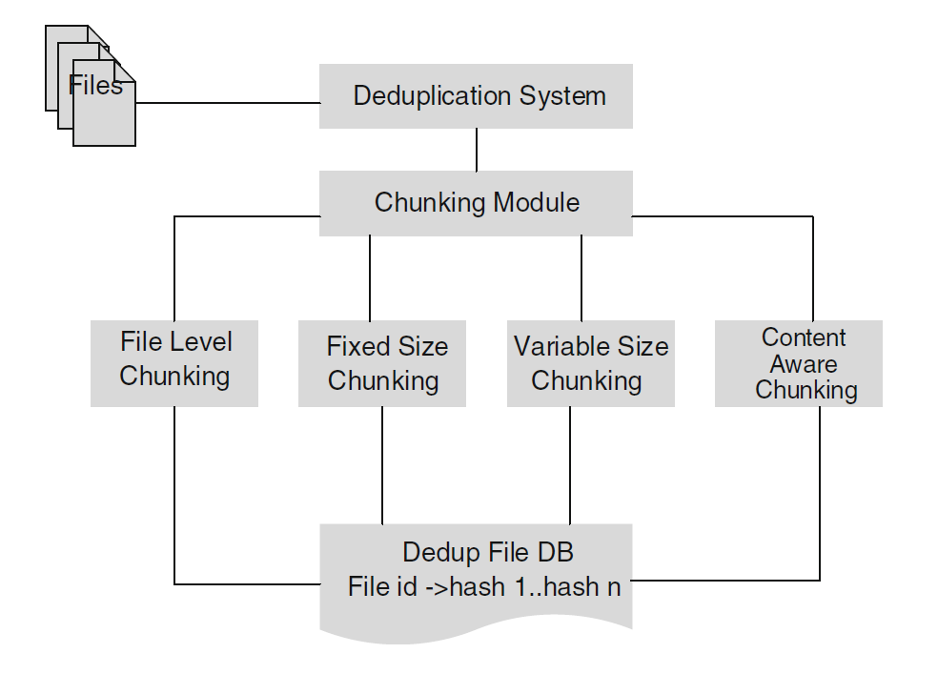
Chunking Algorithm And Fingerprinting

Slide 7
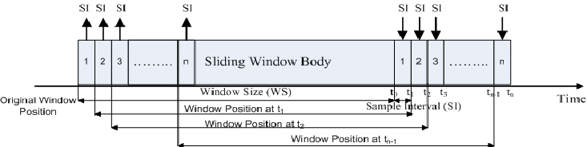
Chunking Algorithm And Fingerprinting
A Popular Chunking Algorithm, Sliding window Algorithm.
It is a variable size Chunking algorithm which is very efficient in chunking of a file in such a way that similar chunks are formed on similar data.

Slide 8
Sliding window Algorithm
In sliding window algorithm, for each chunk ‘n’ bits are considered.
Fingerprint of these n bits is calculated and if this fingerprint follows a predefined rule, say divisible by 37, then a chunk is made.
Otherwise a new fingerprint is calculated after sliding the n bit window by one bit and checked again until the rule is satisfied.
This algorithm successfully solves the shortcomings of file level chunking and fixed size chunking.

Slide 9
Chunking Algorithm And Fingerprinting
Each chunk as discussed previously needs a fingerprint.
Fingerprints should follow two rules, namely:
They should be unique.
They should be easily computable.
A way to achieve this is to simply use a hash function as they are both unique and are easily computable.
Usually hashing algorithms such as SHA1 and MD5 are used for fingerprint.

Slide 10
Storage and Deduplication of Data
Usually a meta data is made which is basically a register linking fingerprint with its corresponding chunk.
Each file has been broken into its corresponding chunks, and they should be linked with its chunks to access the complete fie.
For this various method can be used, like bipartite graph, extreme binning etc. This is the essence of data deduplication.
These methods will be discussed in following slides

Slide 11
Extreme Binning for Deduplication
In Extreme Binning each file is assigned a representative chunk ID, file ID.
Each chunk has a chunk ID which is same as its fingerprint.
For each file its representative chunk ID is the minimum of its corresponding chunk IDs of its chunk.
File Id of a file is the fingerprint/hash of the whole file as a single unit.

Slide 12

Extreme Binning for Deduplication
In extreme binning there are ‘bins’ which are disrtribute according to representative chunk IDs.
If a file and a bin share the same rep chunk ID, according to the above eqn there is a very high probability that they share lot of common chunks.
Such files are then merged with the corresponding bin to save the meta data.
If no bin already exist with the same rep chunk ID, a new bin is created with the files rep chunk ID, and the file is merged with the new bin.

Slide 13
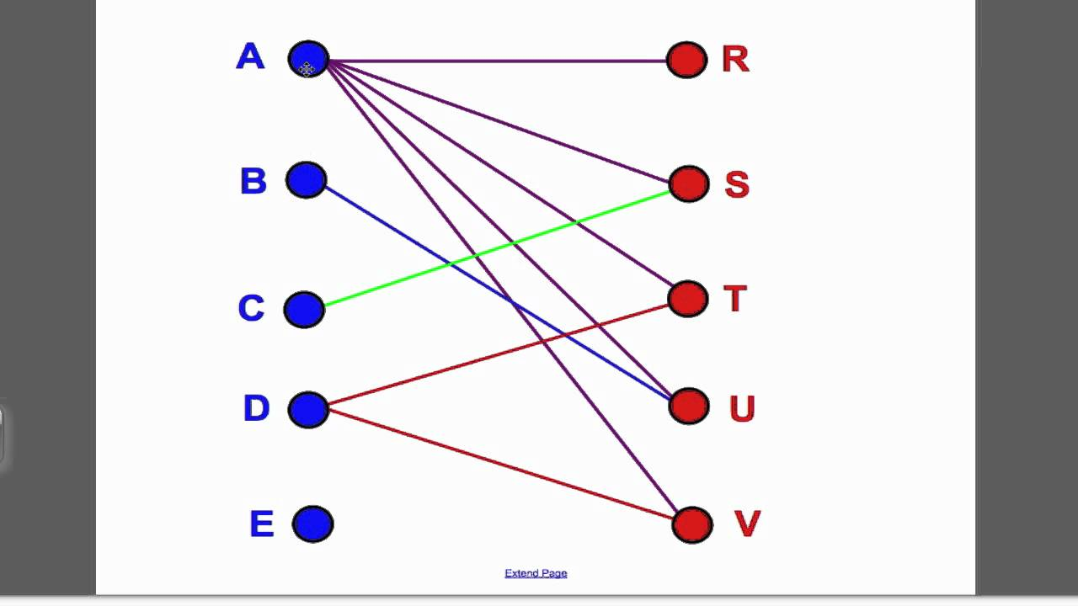
Bipartite Graph for Deduplication.
A Bipartite Graph:

Slide 14
Bipartite Graph for Deduplication
In this method of deduplication, a file is represented as a bipartite graph.
Left side of the graph represent file IDs and right side of the graph has its corresponding chunks.
When a new file is added, its graph is merged with the overall bipartite graph eliminating redundant chunks.

Slide 15
1
A
4
5
1
B
2
3
C
4
5

Slide 16
1
1
A
2
B
3
4
4
C
5
5

Slide 17
Questions.

